Slide 1

Predicting NCAA Shot Completion
Chris Watkins

Slide 2
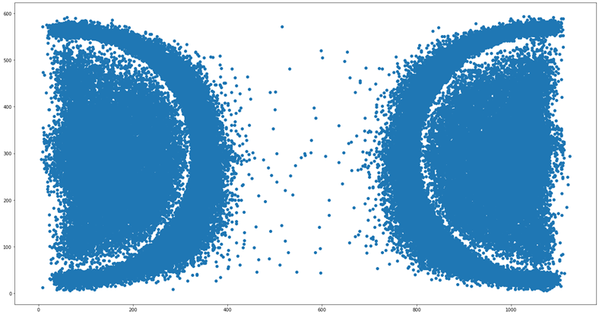
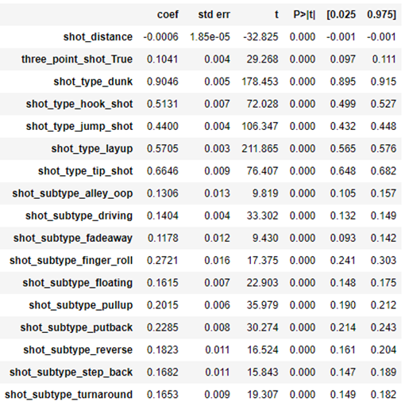
Overall Shots
Few attempts made from just inside the three-point line. Due to high risk, and low return.
As expected, shots such as “dunk” and “tip-in” are strongly correlated with a shot going in.

Slide 3
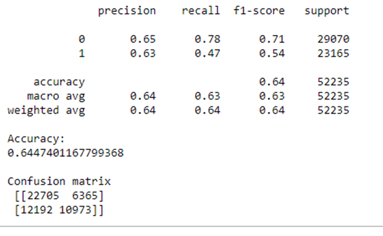
Best Predictive Model
After using multiple methods, we had a clear winner at 64.47% accuracy, this being a Logistic Regression.
The overall worst performing, was a Random Forest Classifier at 59.20%

Slide 4
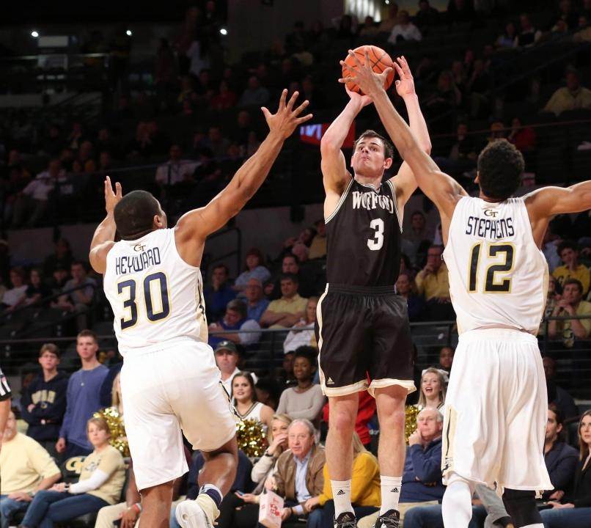
What is Missing From Our Analysis?
We do not have any data in relation to who is actually shooting the ball which would influence our accuracy. To further improve on the model, we could incorporate those features.
This was done on purpose, so we could get an unbiased opinion on overall shots.

Slide 5
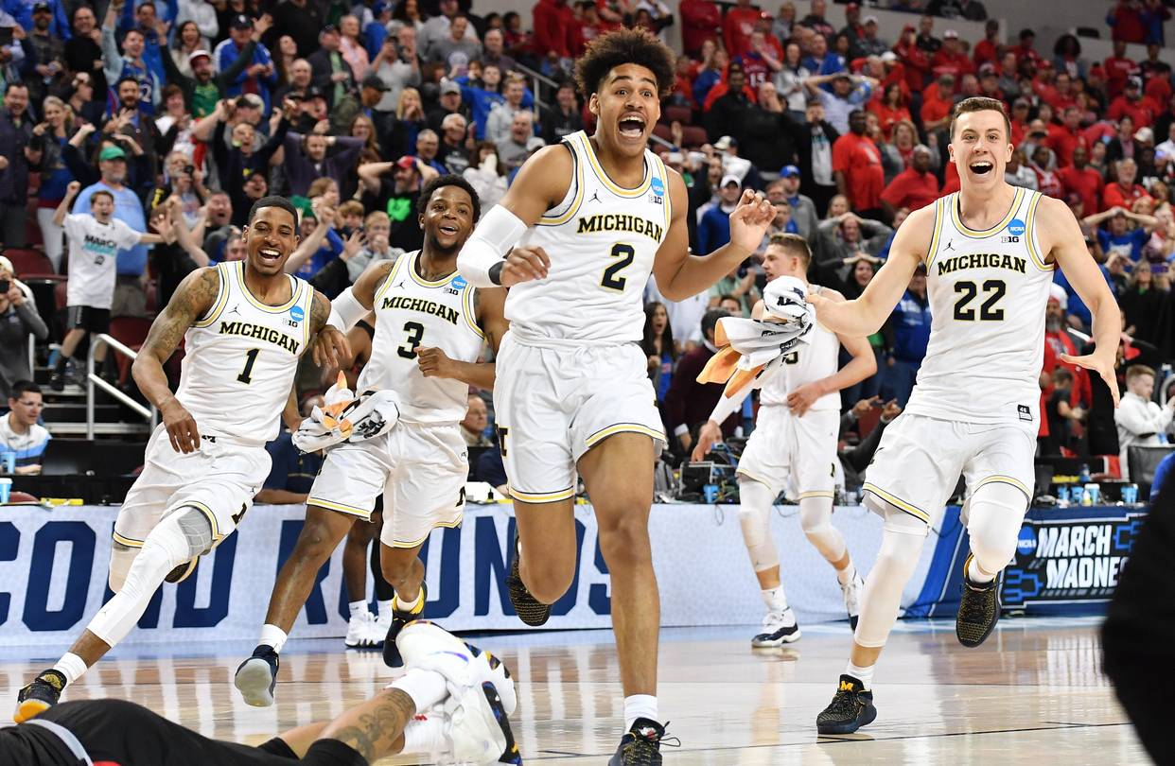
Conclusion
We were able to increase our accuracy over 10% from our initial diagnostic run, however there are still variables that were not introduced.
Anything over a 50% metric was considered a win, as we can see the correlation between the data and our models are working.

